Slide 1
Data 301: Genre Predictions
Josh Abel, Kevin Label

Slide 2


Introduction
Brainstorming (we couldn’t find an old photo of Kevin, so we borrowed one)

Slide 3
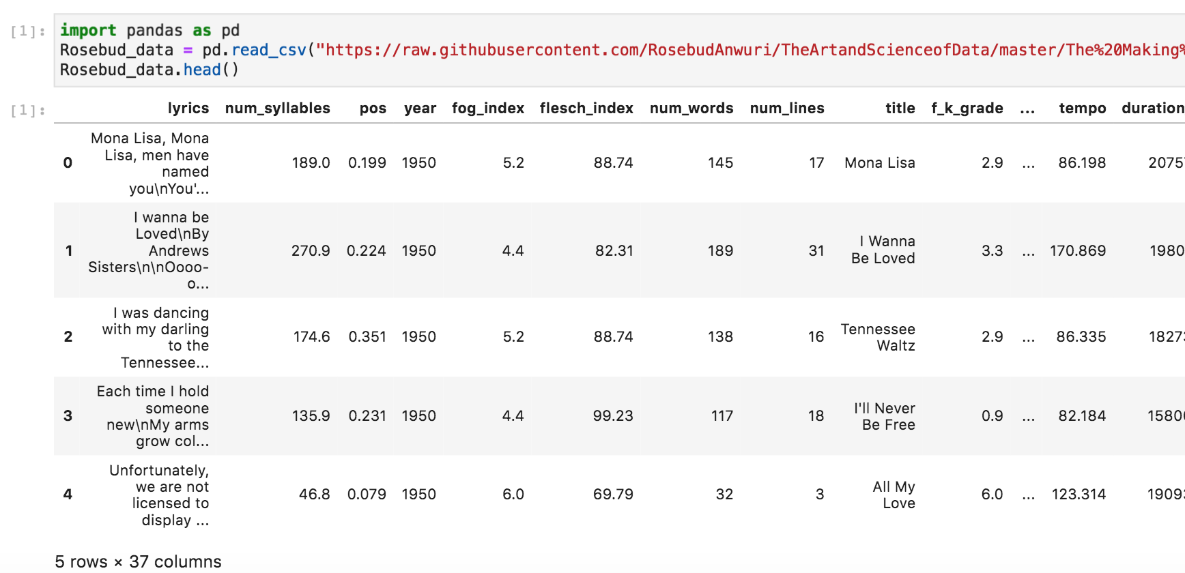
Billboard Top 100 Data
Towardsdatascience.com, credit: Rosebud Anwuri
Spotify API

Slide 4
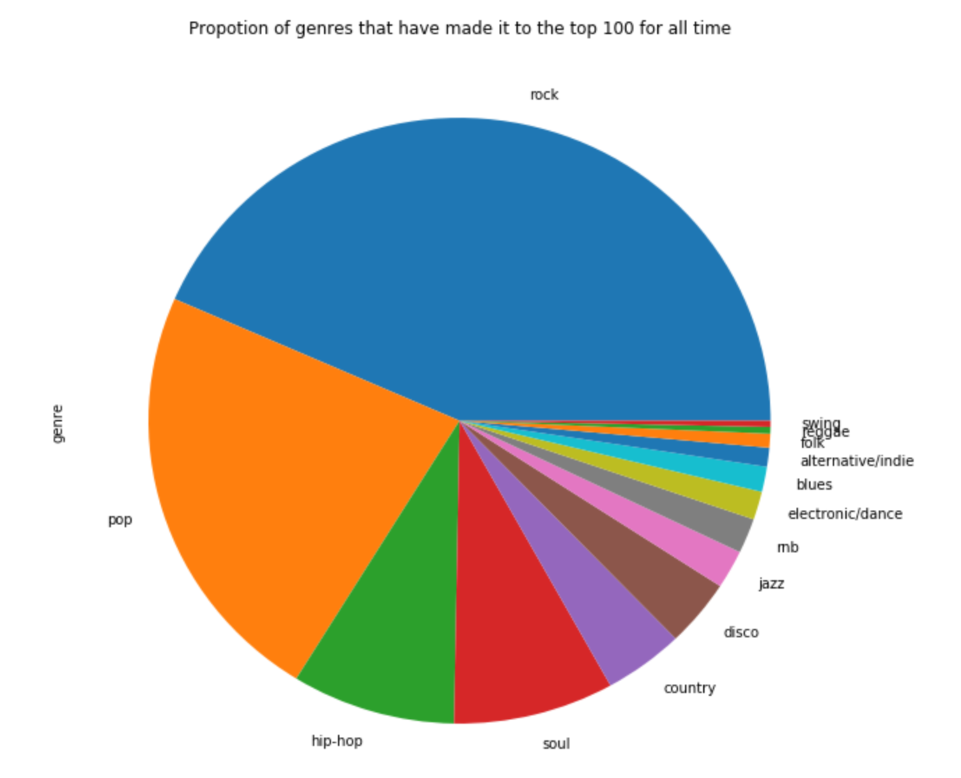
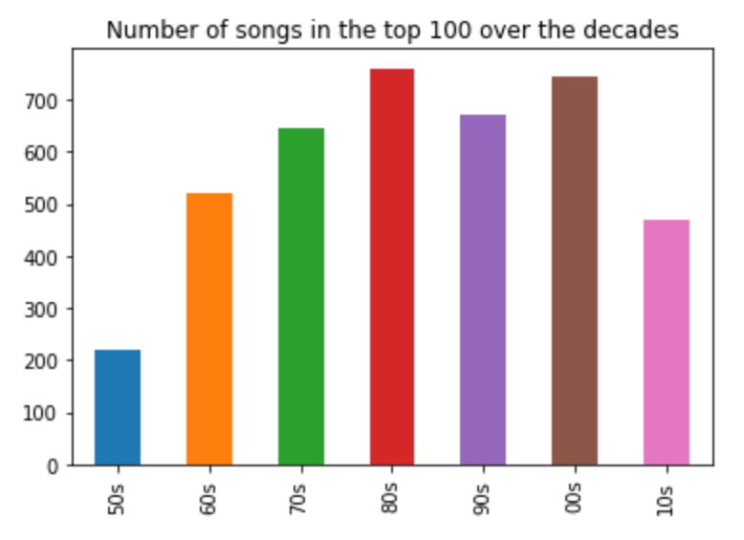
Data Observation

Slide 5
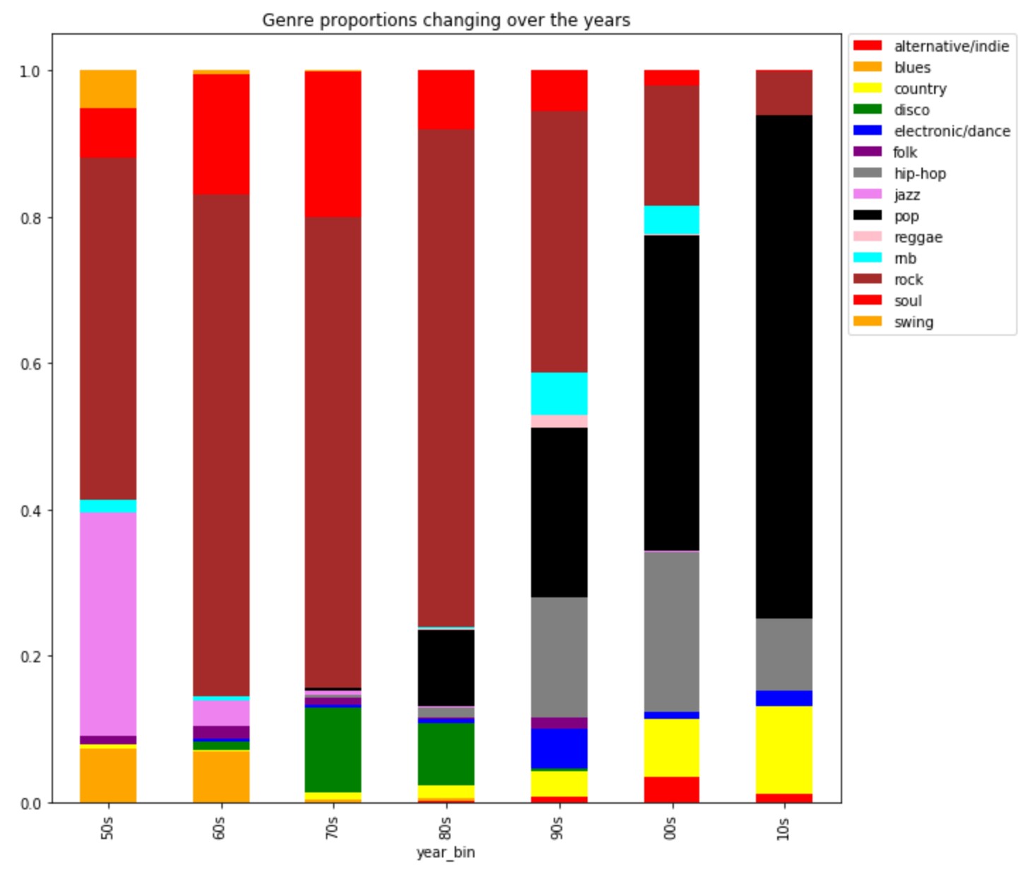

Data Observation (Genre by Decade)

Slide 6
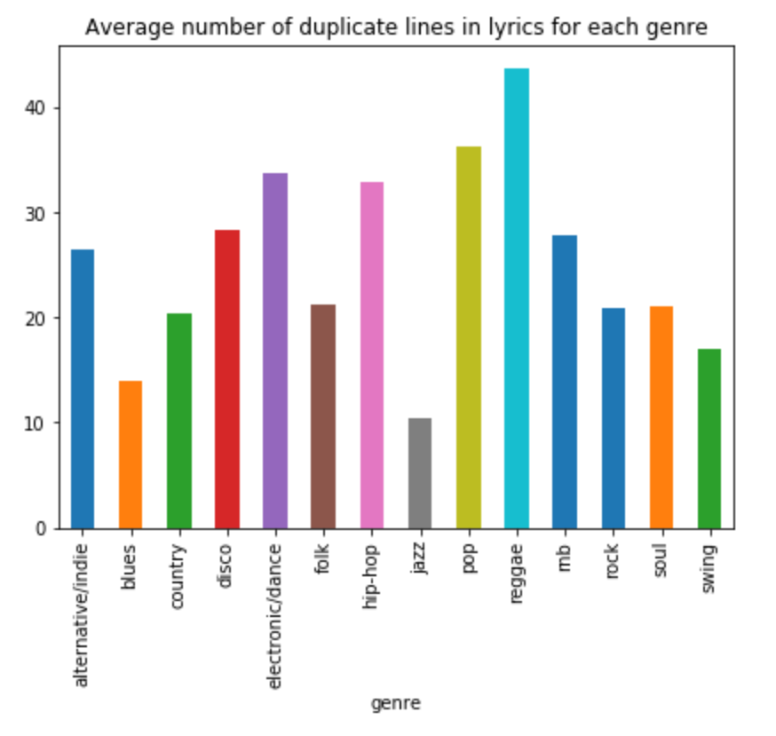
Data Observation (Quantitative Labels)

Slide 7
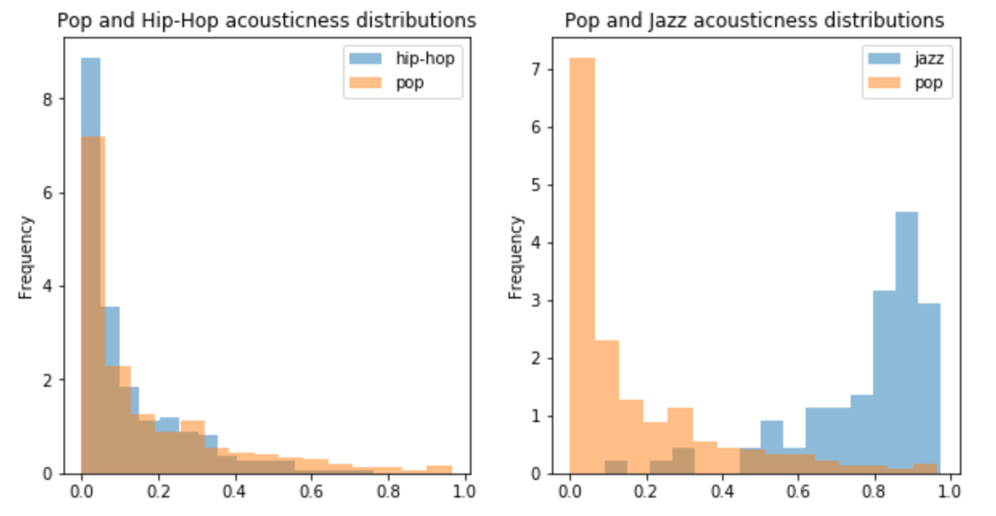
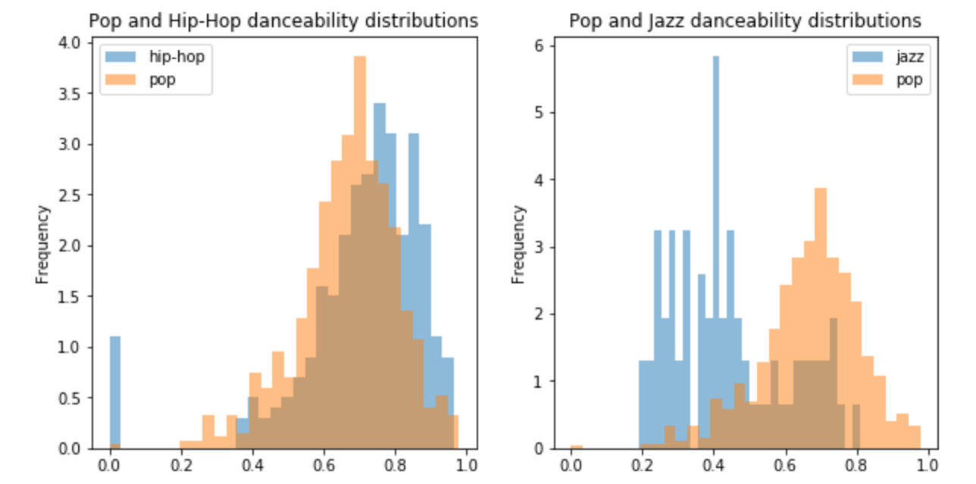
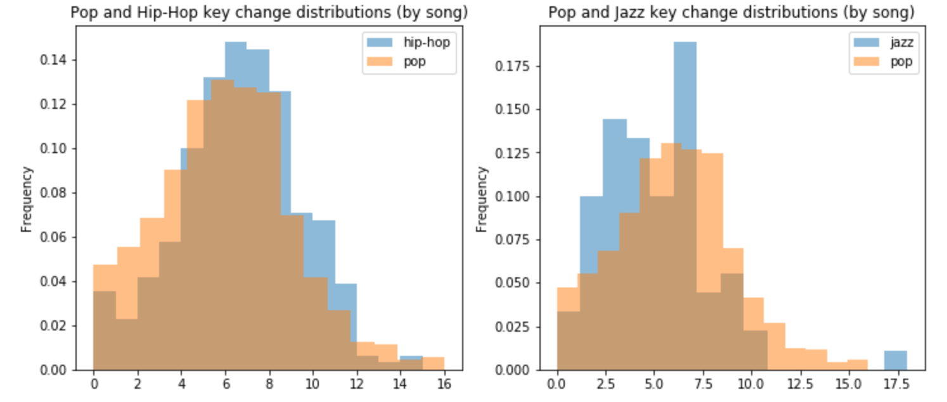
Data Observation (Quantitative Labels cont.)
Other Examples
Obvious Feature Difference
Non-Obvious Feature Difference

Slide 8
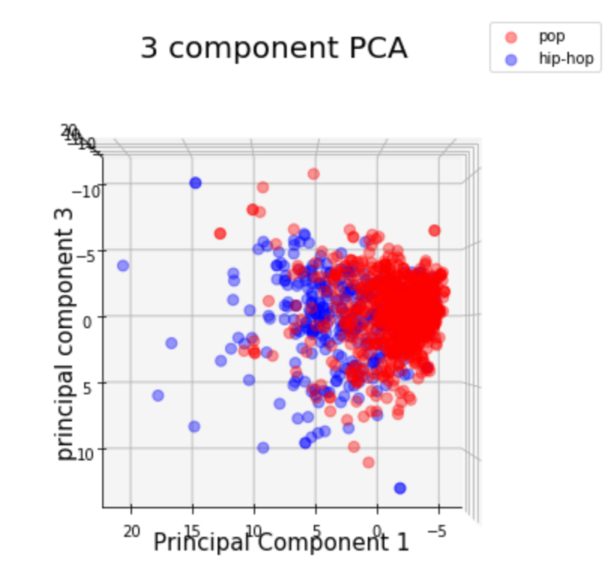
Data Observation (Principal Component Analysis)

Slide 9
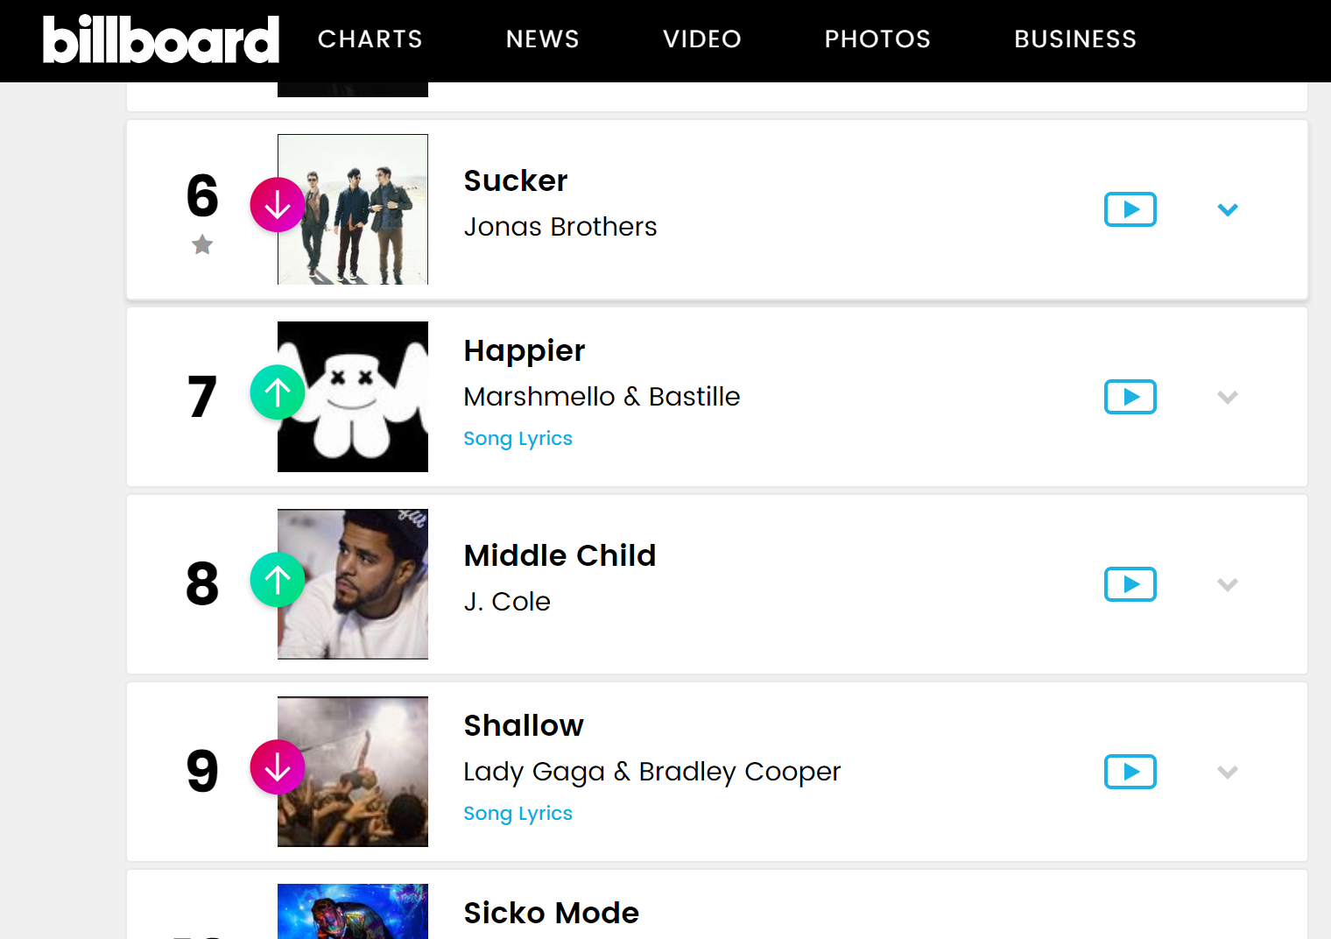
Machine Learning
Process:
SVM
KNN
Ensemble
Choose the best model
Regression Imputation
Run on Current Top 100

Slide 10
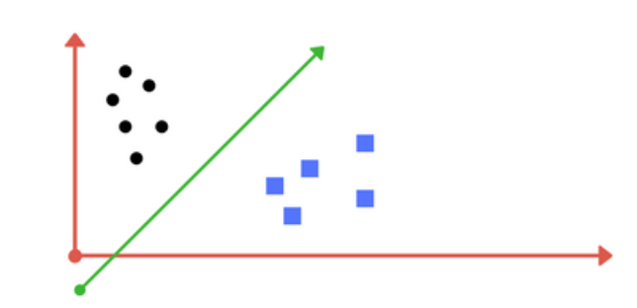
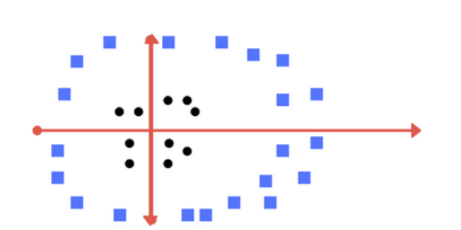
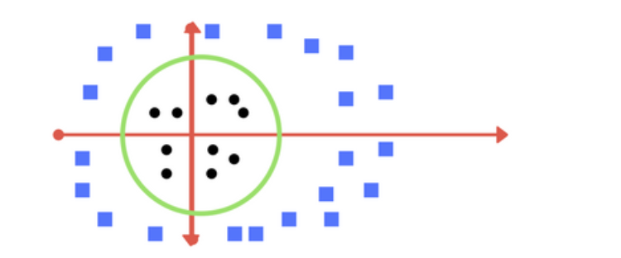
Machine Learning (SVM Model Explained)
Separate Data by Linear Hyperplane
Classify
If not separable, made a new dimension and separate by hyperplane (ex: z = x^2 + y^2)

Slide 11
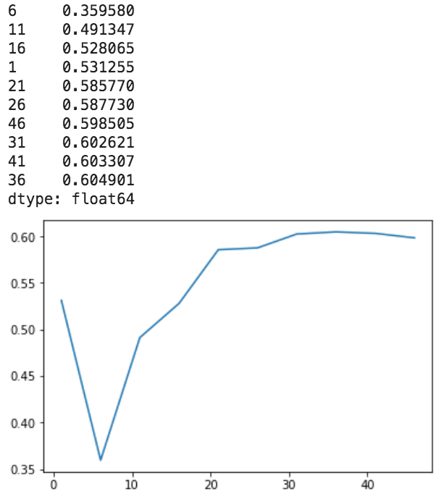
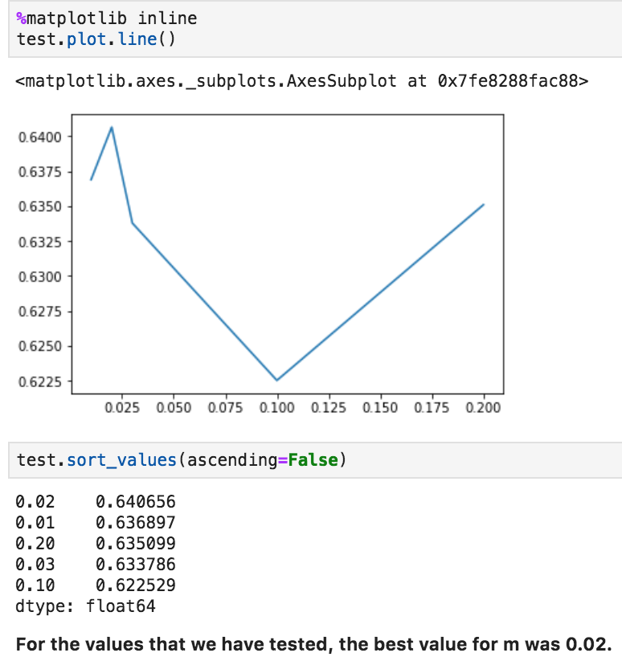
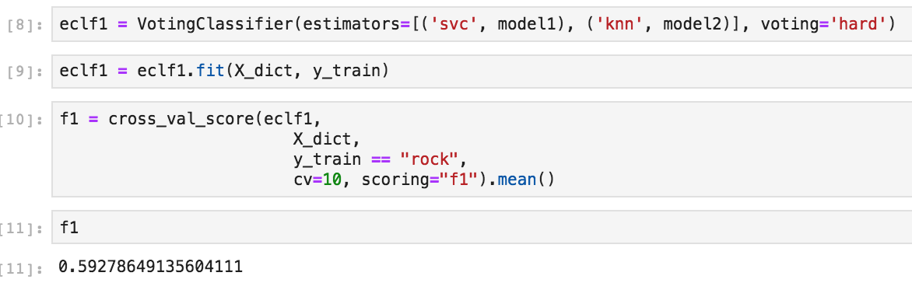
Machine Learning Models and Optimization
Support Vector Machine (SVM) - best
K-Nearest Neighbors
Ensembler

Slide 12
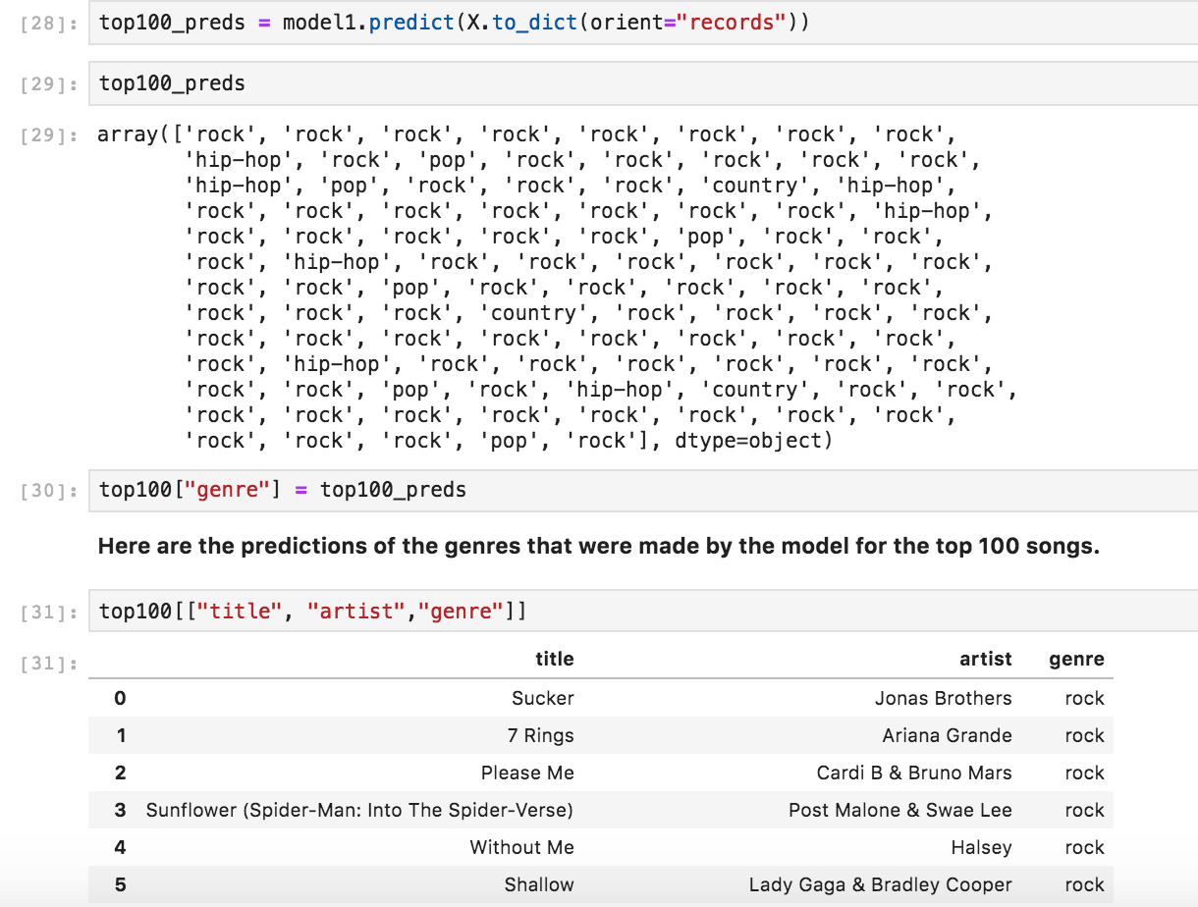
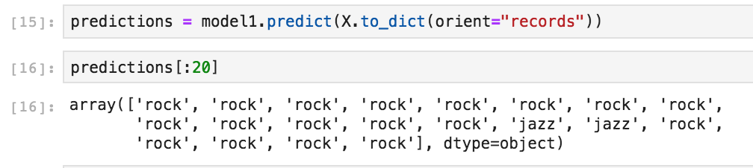
Final Predictions on Top 100
Regression Imputation
Predicting for current 100

Slide 13
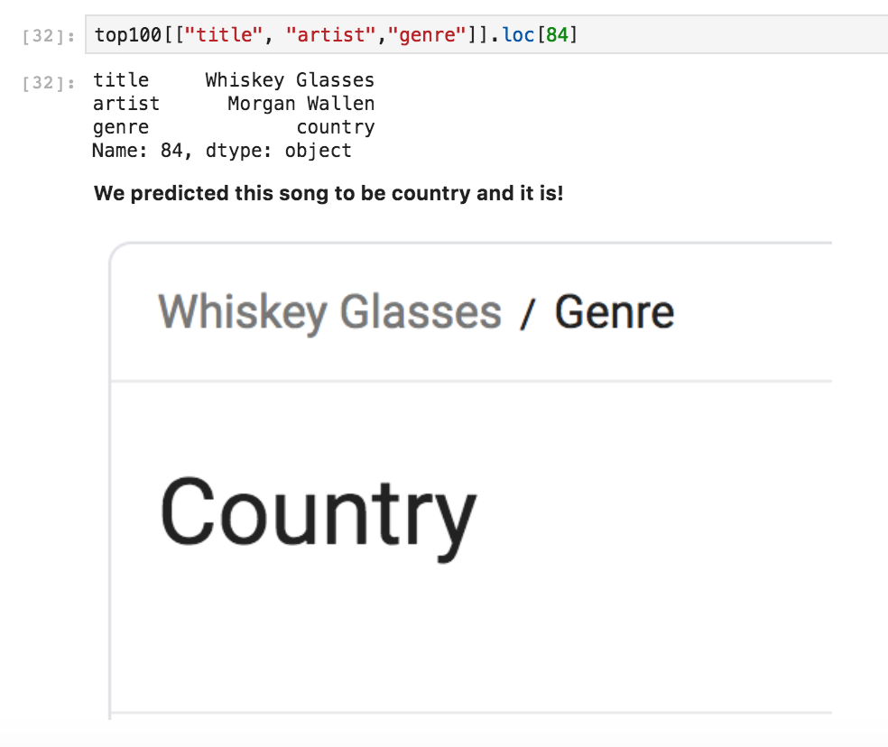
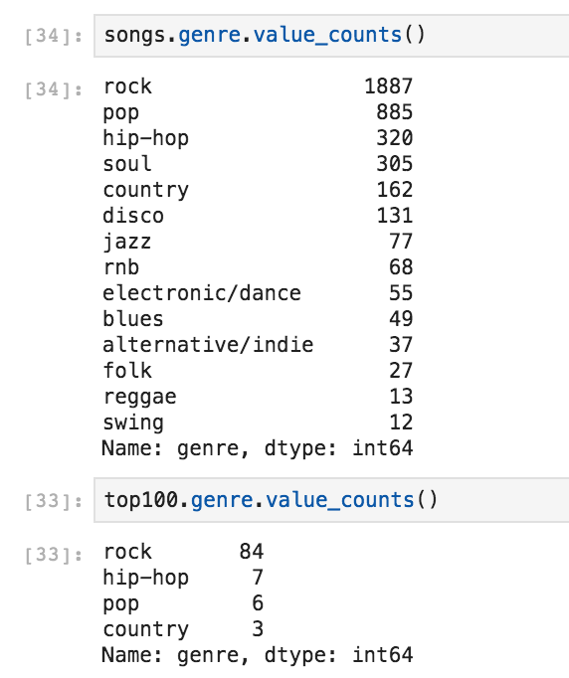
Country Observation

Slide 14
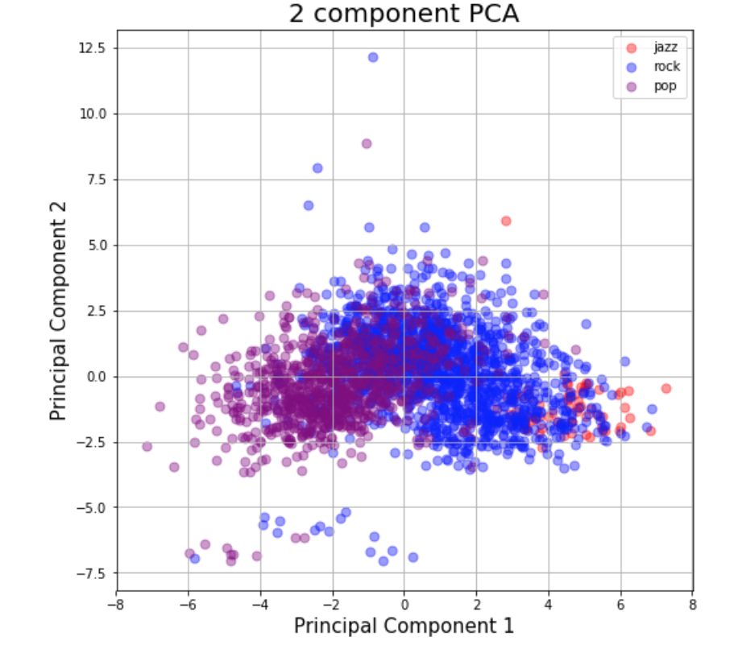
Final Conclusions

Slide 15
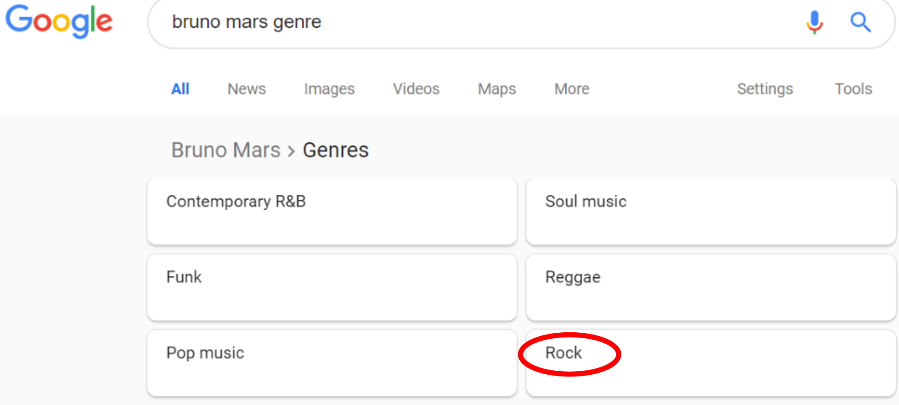
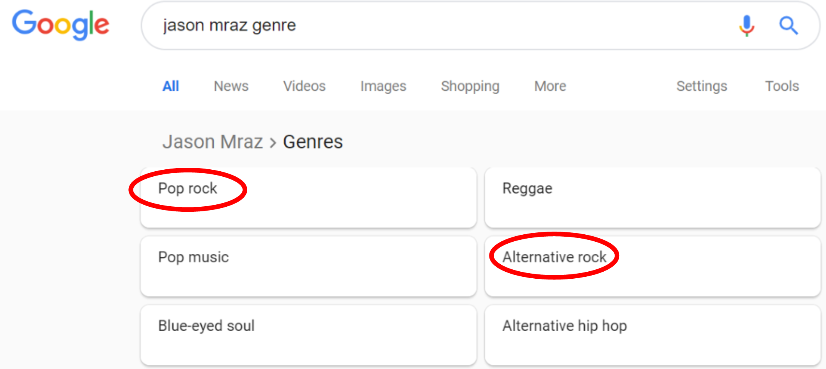
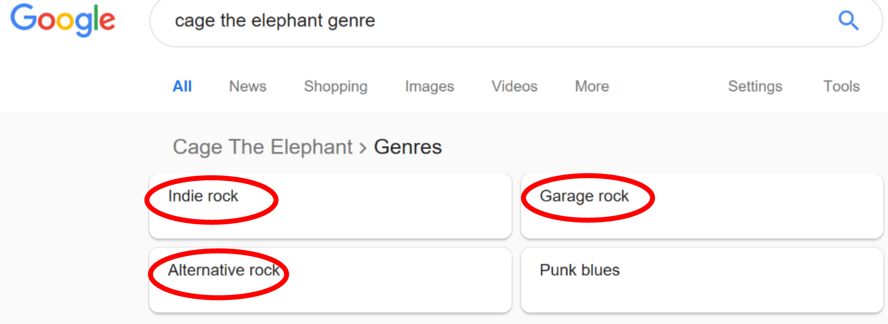
Final Conclusions

Slide 16
Thank you
Questions?

